Slide 1

G2M Case Study
Virtual Internship
21-Apr-2023

Slide 2
Background –G2M(cab industry) case study
XYZ is a private equity firm in US. Due to remarkable growth in the Cab Industry in last few years and multiple key players in the market, it is planning for an investment in Cab industry.
Objective : Enabling XYZ company to invest in the right company by analyzing and visualizing data more efficiently.
DATA WAS DIVIDED THREE PARTS :
1.UNDERSTAND DATA CLEARLY
2.BASED ON DATASET TO FIND A COMPANY WHICH HAVE MORE PROFIT
3. RECOMMEND THE COMPANY WHICH ARE SUITABLE TO INVEST

Slide 3
Data Exploration
14 Features
Timeframe of the data: 2016-01-31 to 2018-12-31
Total data points :439585
Cab_Data.csv
Customer_ID.csv
Transaction_ID.csv
City.csv
Final cab data

Slide 4
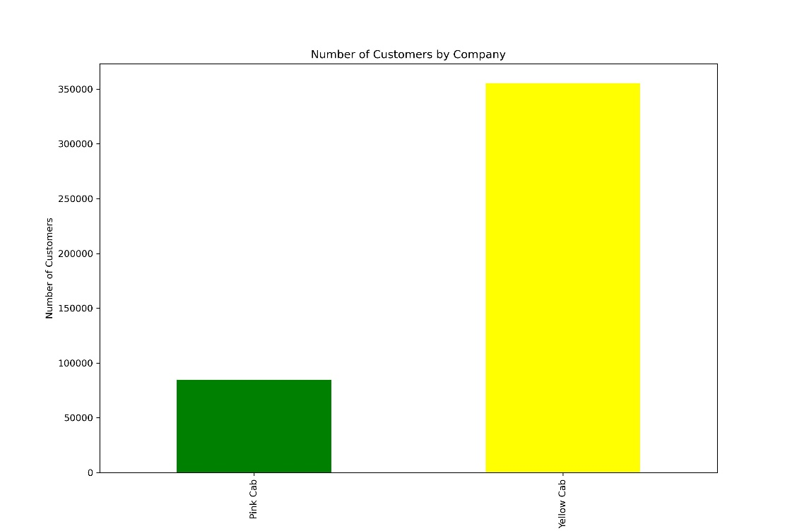
Number of customers by Companies
Yellow Cab taxi company users are almost 3 times more than Pink Cab users

Slide 5
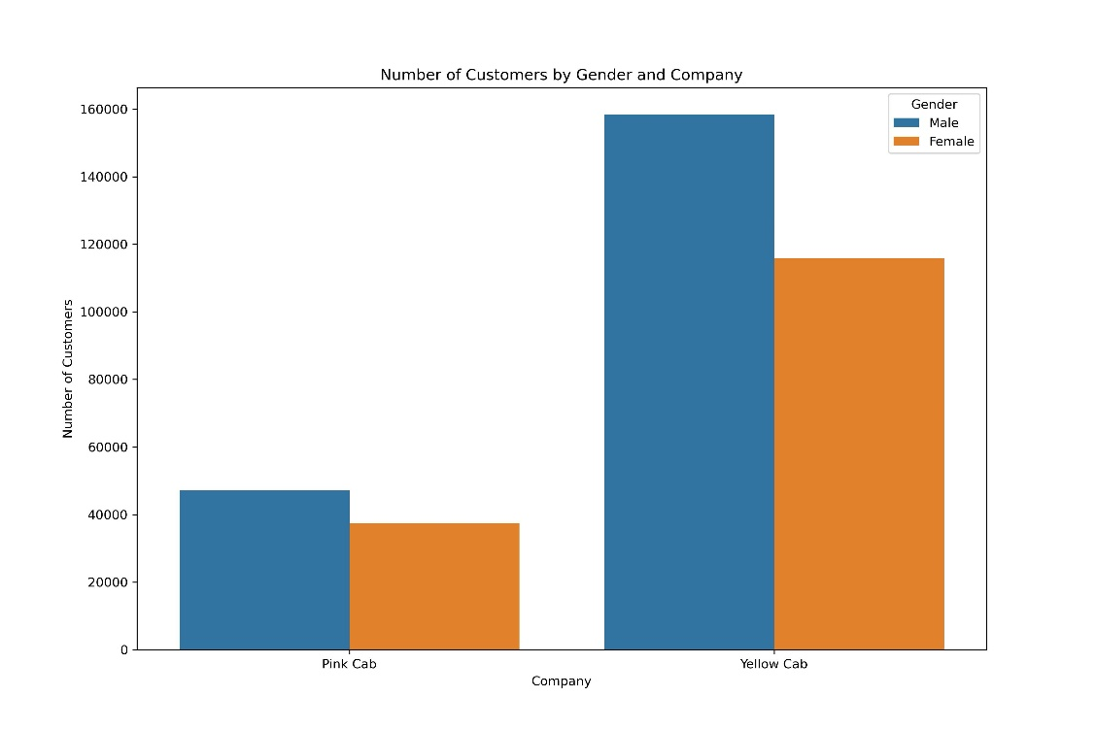
Number of customers by Gender and Companies
The majority of users in both companies are men.

Slide 6
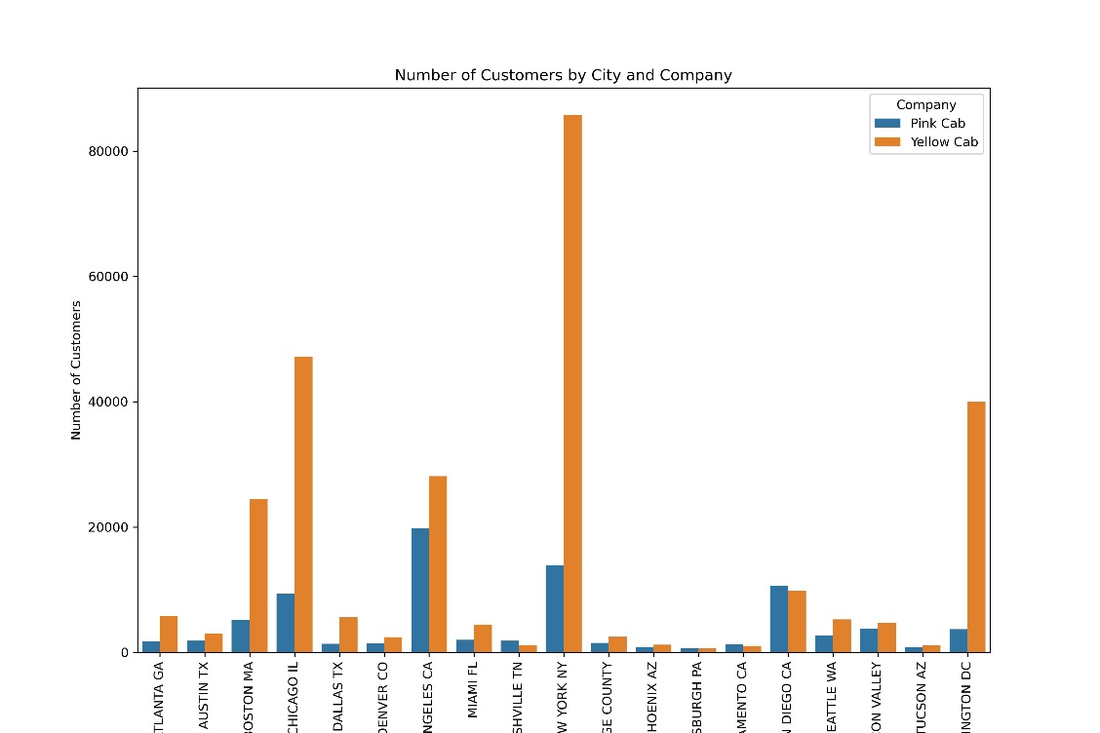
Number of customers by City and Companies
Most majority of customers in cities use Yellow Cab Taxi

Slide 7
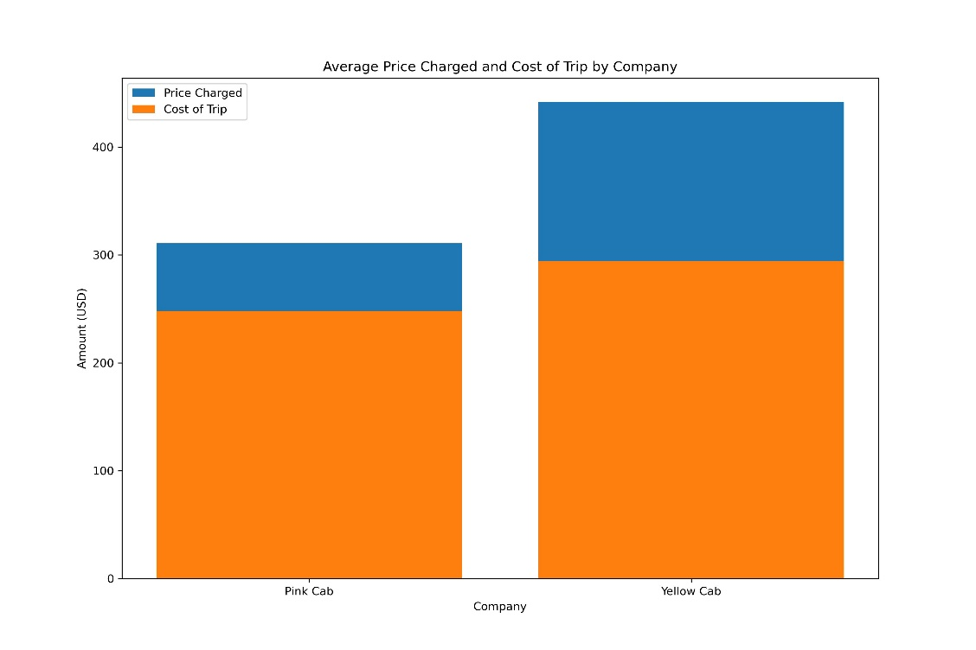
AVERAGE Price Charged and Cost of Trip by Company
Average price charged and cost of trip are higher in Yellow Cab Taxi Company.

Slide 8
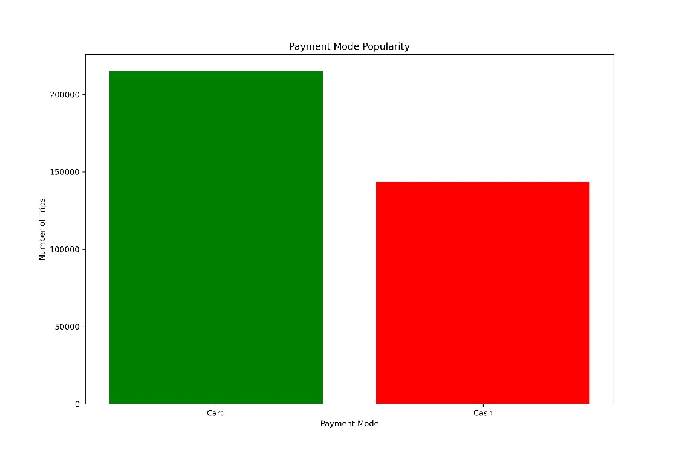
Payment Mode Popularity
Most majority of customers prefer to pay by card rather than cash

Slide 9
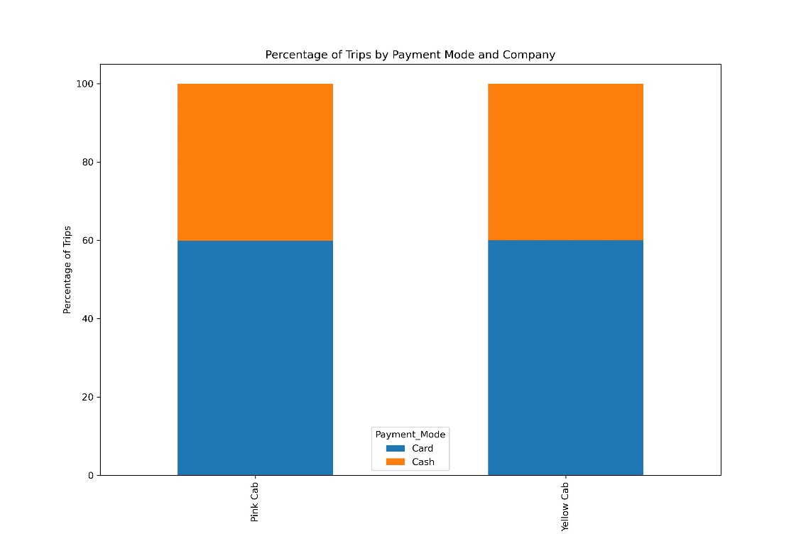
Percentage of Trips by Payment Mode and Company
It is almost 60% of each company' customers prefer to pay by card

Slide 10
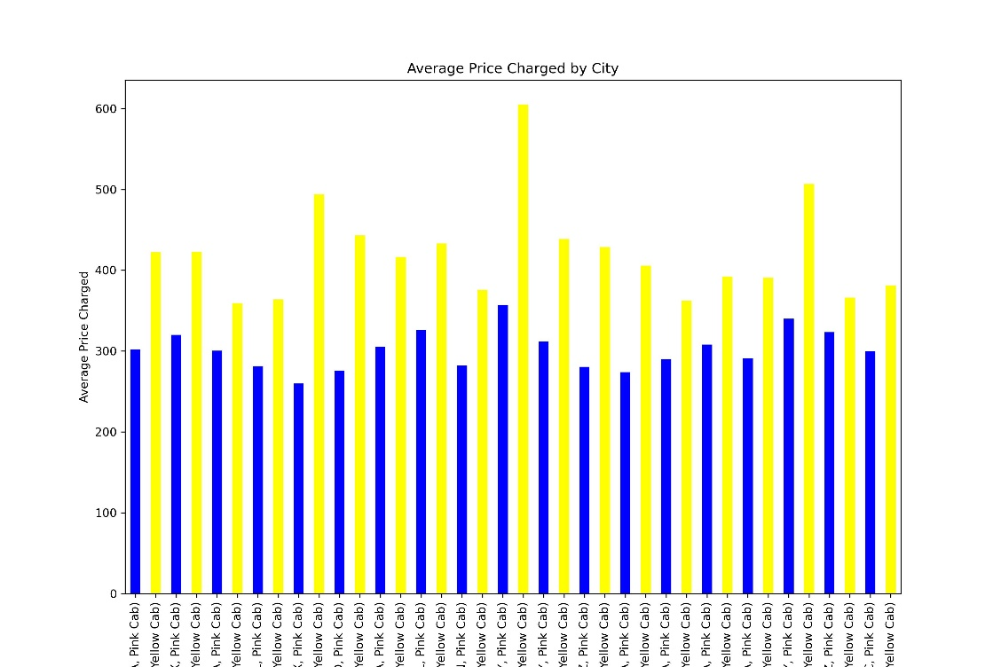
AVERAGE Price Charged by City for each company
We clearly observe that Yellow Cab's average price charged is higher than Pink Cab in each city.

Slide 11
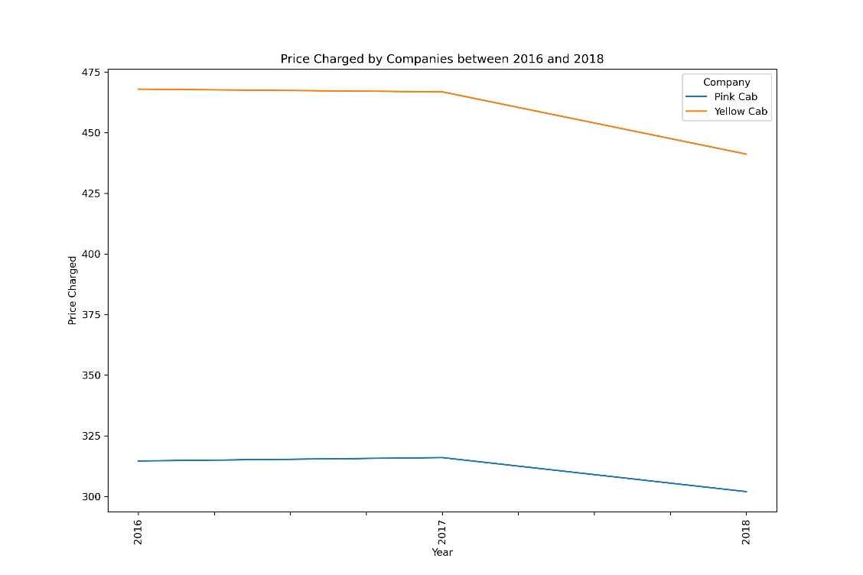
AVERAGE Price Charged by Companies between 2016 and 2018

Slide 12
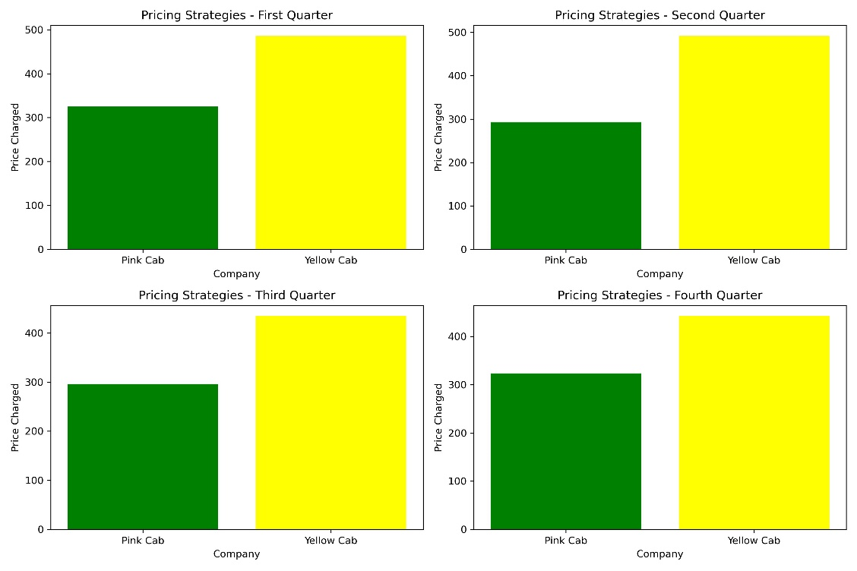
AVERAGE Pricing Strategies FOR EACH Quarter OF YEAR

Slide 13
Recommendations
1.Customers prefer to card payment model rather than cash.
2.There is a slow decrease in the price of taxi companies between 2016 and 2018.
3.Companies have a different pricing strategy for each quarter of the year.
4.Yellow Cab has more customers than Pink Cab
5.Yellow Cab Taxi Company's average price charged and cost of trip is higher than Pink Cab.
6. Most majority of customers in cities use Yellow Cab Taxi
7. Yellow Cab Taxi Company's average price charged is higher than pink cab in each city.
Based on these data, we can say that the Yellow Cab offers more advantages for investment.

